Slide 1


FED TAPERING
ARBITRAGE

Slide 2

Understanding ‘Arbitrage’
– By Prof. Simply Simple TM

Slide 3
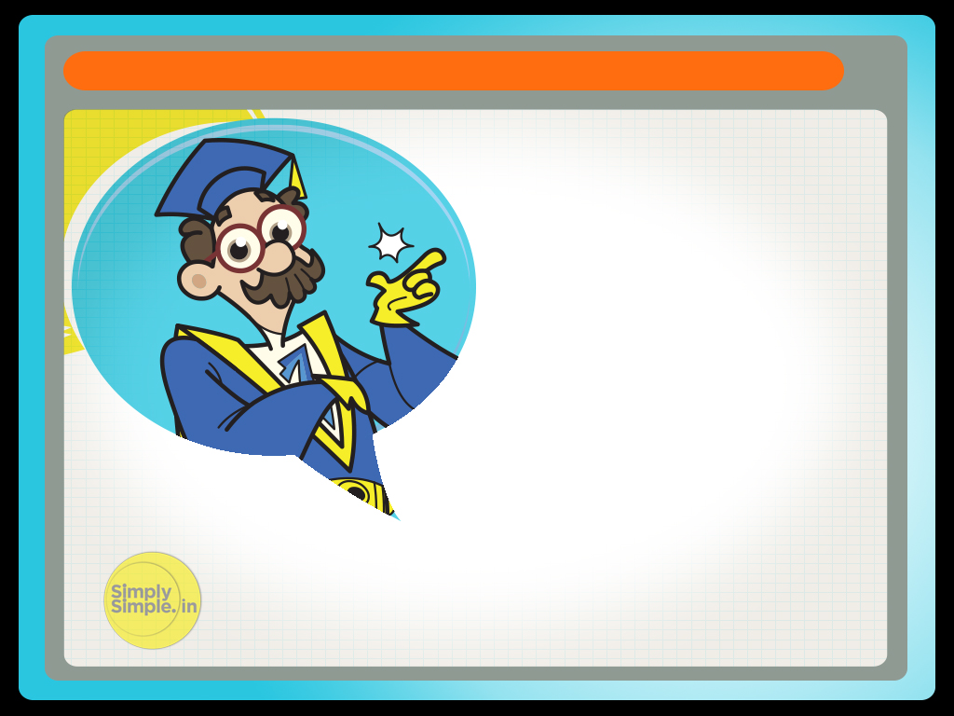
ARBITRAGE
Let me tell you a story about a “Chaalu Chaiwala”!
He was truly chaalu or shall we say, “Extra Smart”!!

Slide 4

ARBITRAGE
He would provide tea at Rs 5 per cup and his cost of preparing the same was Rs 4.
Thus he made a profit of Rs 1.
But he was not happy with making a profit of just Rs 1.

Slide 5

ARBITRAGE
So he thought about how he could increase his profit.
It was then that he had a brainwave out of the blue!

Slide 6
ARBITRAGE
He identified a Government canteen which offered tea at Rs 2.
BIG IDEA! Wasn’t it?
He could now simply buy tea for Rs 2 and sell it for Rs 5 and make a much better gain of Rs 3!

Slide 7
ARBITRAGE
This buying of a thing in one market and selling in another market at a higher price is known as “Arbitrage”.
Similarly if arbitrage opportunities exist, stocks too can be purchased in one market at a lower cost and sold in another at a higher cost.

Slide 8
ARBITRAGE
So for the next few days, our Chaalu Chaiwala had a field day earning happily as he served his daily chai.
But Alas! Such arbitrage opportunities do not last long.
As information flow increases and the arbitrage opportunity gets known, it soon starts to disappear.

Slide 9
And this is exactly what happened in the case of our “chaiwala”.

Slide 10
ARBITRAGE
The chaiwala had an assistant who one day spilled the beans about the “arbitrage” advantage being enjoyed by the chaiwala.
Soon after that, the chaiwala was rounded up and he confessed about the arbitrage opportunity he had spotted.

Slide 11
ARBITRAGE
Since his customers, in a sense, had been paying a fair price all this while since Rs 5 had been the standard retail price in all canteens, the chaiwala was forgiven but was warned against adopting this practice again.
So the arbitrage opportunity too vanished in thin air as the
very next day, he was back in his own canteen making tea at
Rs 4 and selling it at Rs 5.

Slide 12
ARBITRAGE
Thus it’s important to understand that “arbitrage” opportunities are short-lived.
It is essentially a short window of opportunity that can be exploited by taking action at the right time.
As information flow gets efficient, this opportunity vanishes as we saw in the case of the chaiwala.

Slide 13
ARBITRAGE
Hope this story succeeded in clarifying the concept of ‘Arbitrage’

Slide 14

Please give me your feedback at
professor@tataamc.com

Slide 15

DISCLAIMER
The views expressed in this lesson are for information purposes only and do not construe to be any investment, legal or taxation advice. The lesson is a conceptual representation and may not include several nuances that are associated and vital. The purpose of this lesson is to clarify the basics of the concept so that readers at large can relate and thereby take more interest in the product / concept. In a nutshell, Professor Simply Simple lessons should be seen from the perspective of it being a primer on financial concepts. The contents are topical in nature and held true at the time of creation of the lesson. This is not indicative of future market trends, nor is Tata Asset Management Ltd. attempting to predict the same. Reprinting any part of this material will be at your own risk. Tata Asset Management Ltd. will not be liable for the consequences of such action.
Mutual Fund investments are subject to market risks,
read all scheme related documents carefully.

